Slide 1
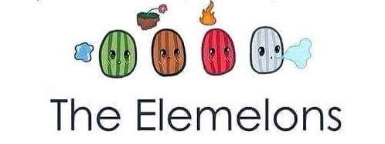
Ele-Melons and Friends!
Michael Atienza
Jan Redilla
Patrick Pamplona

Slide 2
Introduction
Ele-Melons and Friends is a side-scrolling troop fighting game where plants and other natural structures train special melons to rescue their kidnap friend.

Slide 3
Story
The land of Frutzenveggies is filled with wonderful Fruitizens and Veggielians. They are living happily and peacefully until the Rodizents and Pestiors planned an invasion in their land. They kidnapped some of the citizens of Frutzenveggies and it is up to the selected Ele-Melons to save the citizens of Frutzenveggies!

Slide 4
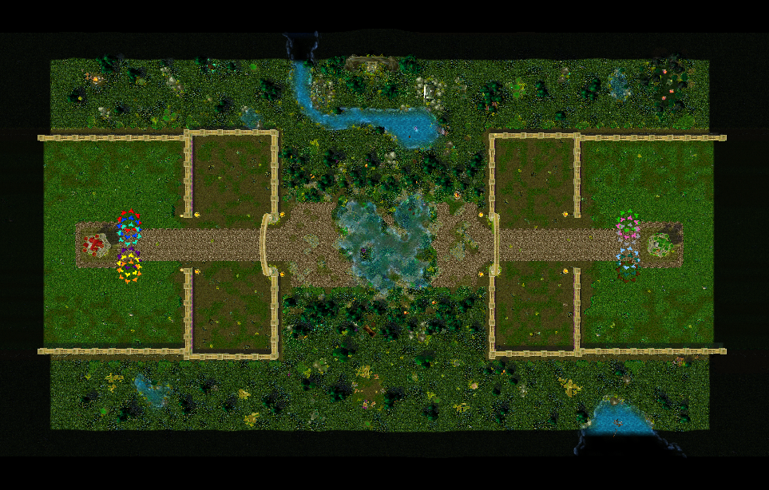
Gameplay
The game will be composed of three major parts:
Side scroll field.
Fruitizens and Veggielians’ base on the left
Rodizents and Pestiors’ base on the right

Slide 5
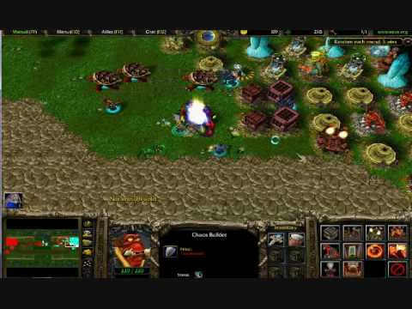
Gameplay
The game will be composed of three major parts:
Plants and Natural structure building
Structures that trains elemelons and friends

Slide 6
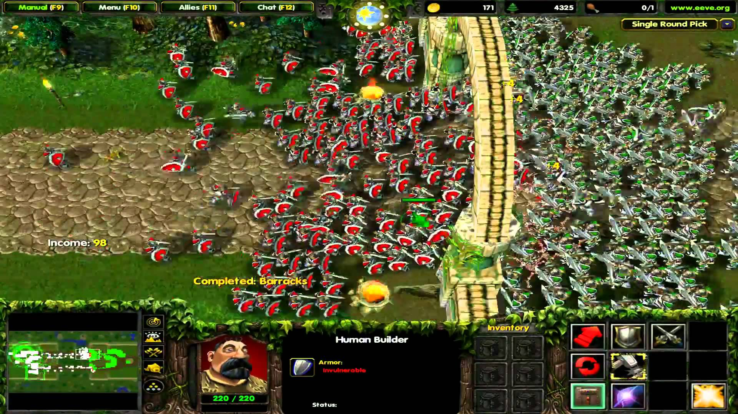
Gameplay
The game will be composed of three major parts:
Clash system
The trained Fruitizens and Veggielians go out to fight againts the Rodizents and Pestiors

Slide 7
Gameplay
The goal of the game is:
To defeat the enemy in the selected territory
Rescue the captured citizen of Fruitzenveggies
Optional: to make the rescued citizen be a troop members

Slide 8
Development Flow
Gameplay Idea
Design Presentation
Project Setup
Structure Design
+
Character Design +
Start Base Coding
Mock Up Assets
+
Gameplay Coding
UI Design/Flow Planning
+
Gameplay Coding
Animations
+
Gameplay Coding
+
AI Coding
Asset Integration
+
AI Coding
Finalize

